Slide 1
Saliency Methods for Explainability
Abir Das
Assistant Professor
Computer Science and Engineering Department
Indian Institute of Technology Kharagpur
http://cse.iitkgp.ac.in/~adas/

Slide 2
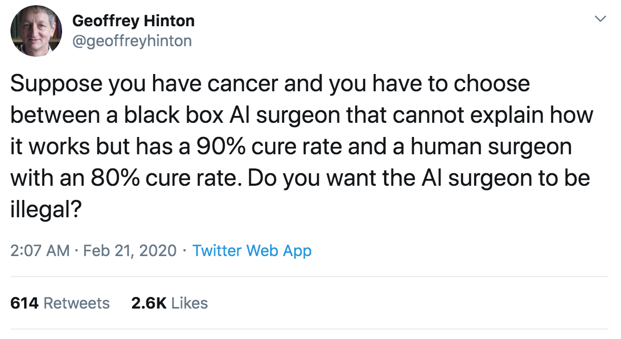
What has a Forefather to Say about Explainability

Slide 3
Talk Information
Outline:
Need for explainability
Activation/Gradient based XAI Approaches
Activation maximization
Activation map
Occlusion based XAI Approaches
Prerequisites:
Familiarity with Deep Learning fundamentals
Proficiency in Pytorch (for the Hands-on session)
1 Hr 15 minutes of presentation, 15 minutes break, 1 Hr Hands-on session
Hands-on notebook hosted in: https://github.com/agarwalsiddhant10/xai_isact_2021

Slide 4
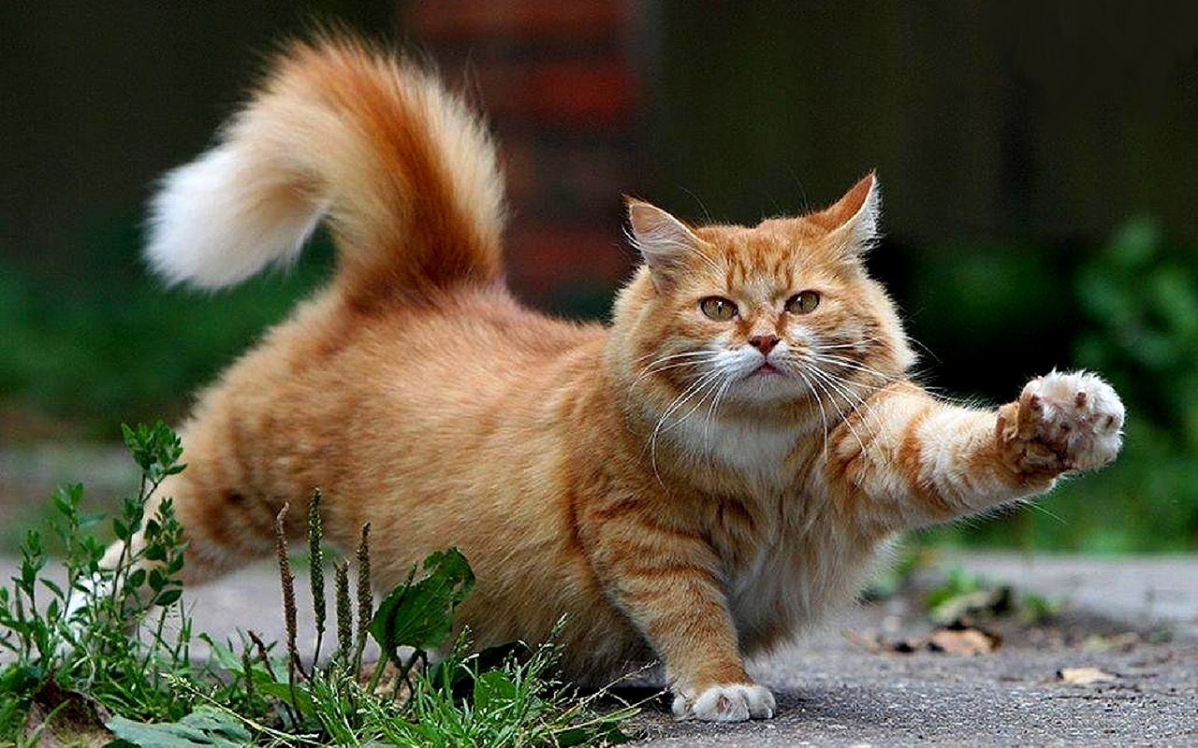
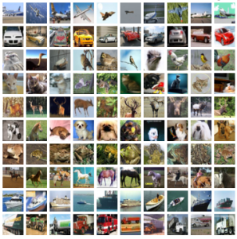
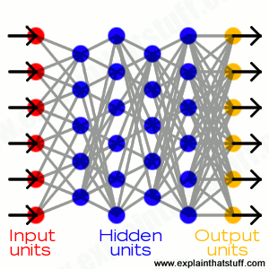



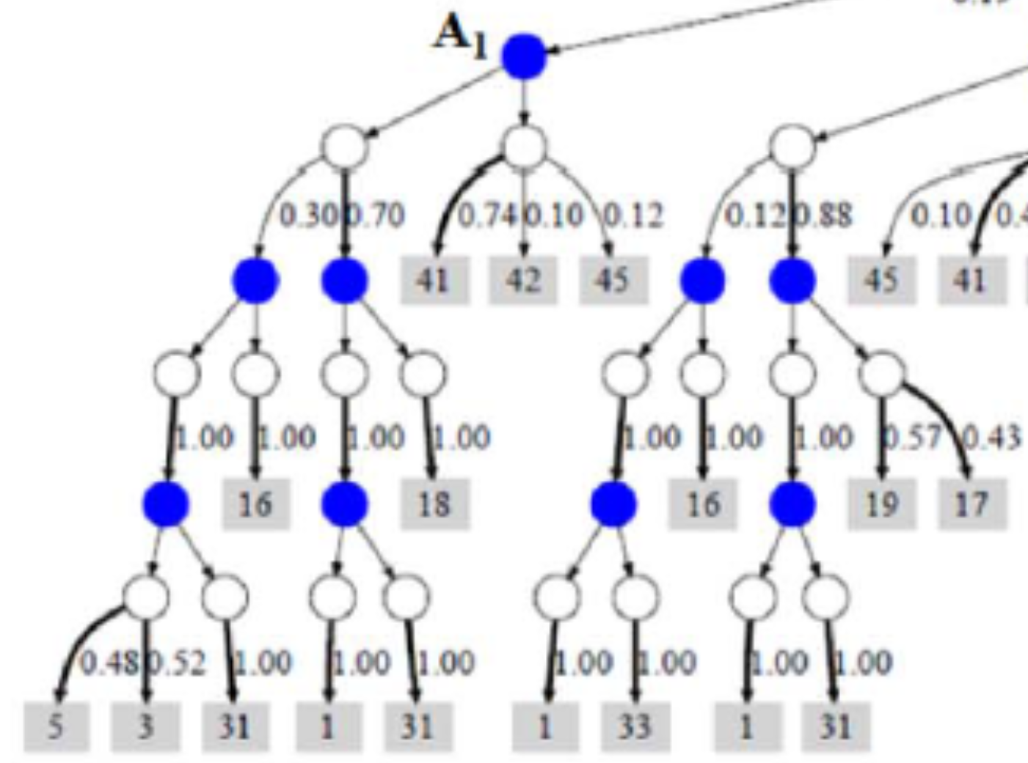

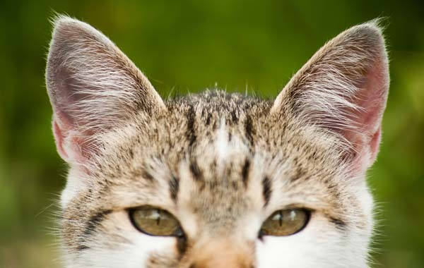
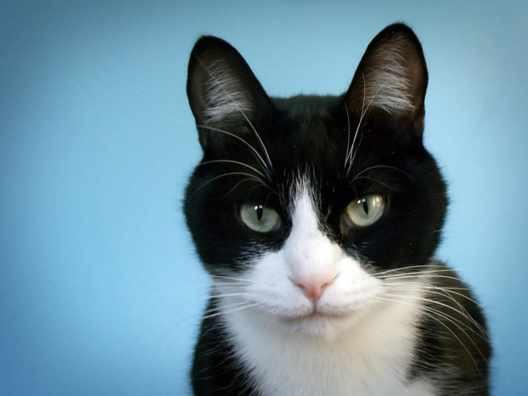
Today
©Spin South West
Why did you do that?
Why not something else?
When do you succeed?
When do you fail?
When can I trust you?
How do I correct an error?
Learning
Process
This is a cat
(p = .93)
©University Of Toronto
http://explainthatstuff.com
Training
Data
Learned
Function
Output
User with
a Task
Tomorrow
©Spin South West
I understand why
I understand why not
I know when you’ll succeed
I know when you’ll fail
I know when to trust you
I know why you erred
New
Learning
Process
This is a cat:
It has fur, whiskers, and claws.
It has this feature:
©University Of Toronto
Training
Data
Explainable Model
Explanation Interface
User with
a Task
Slide courtesy: David Gunning, DARPA XAI Program Manager

Slide 5
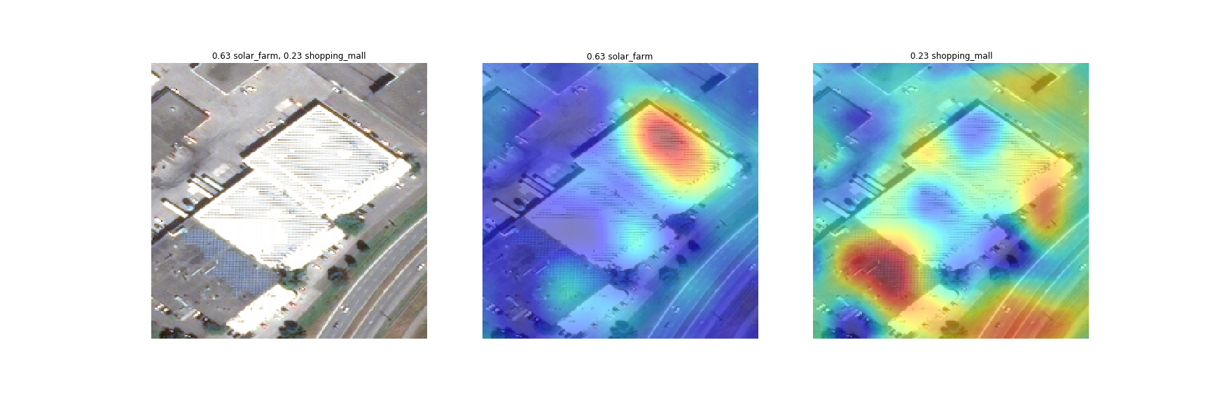
Why Do We Need Explainable AI
○ explain prediction
Neural network prediction:
solar farm: 63%, shopping mall: 23%
Slide courtesy: Kate Saenko, Boston University

Slide 6
Why Do We Need Explainable AI
○ explain prediction
Neural network prediction:
solar farm: 63%, shopping mall: 23%
Explanation for “solar farm”
Explanation for “shopping mall”
Slide courtesy: Kate Saenko, Boston University

Slide 7
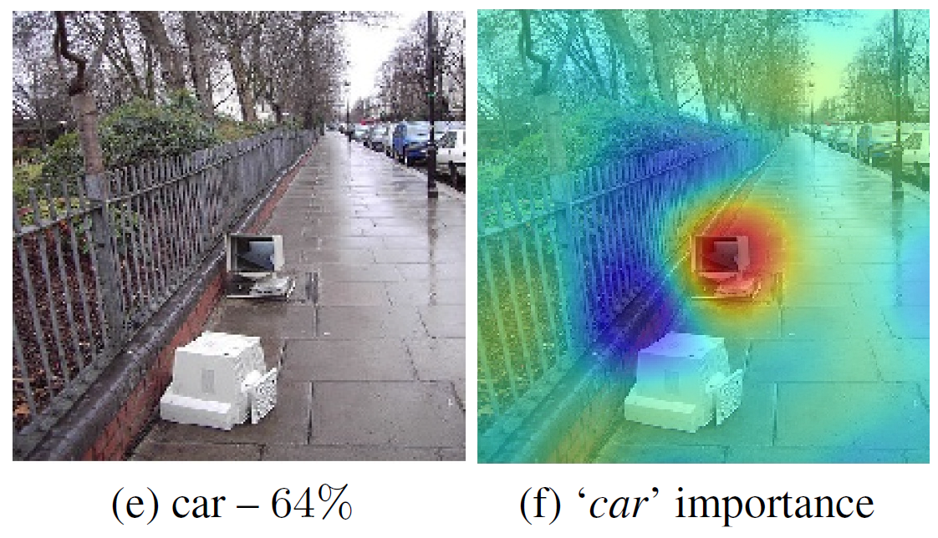
Why Do We Need Explainable AI
○ explain prediction
○ Improve the model
Why did the classifier predict “car”?
Prediction: “car” 64%
Slide courtesy: Kate Saenko, Boston University

Slide 8
Why Do We Need Explainable AI
○ explain prediction
○ Improve the model
Why did the classifier predict “car”? – correct but for wrong reasons!
Prediction: “car” 64%
Explanation for “car”
Cars parked
actual reason is a
monitor and street
context
Slide courtesy: Kate Saenko, Boston University

Slide 9
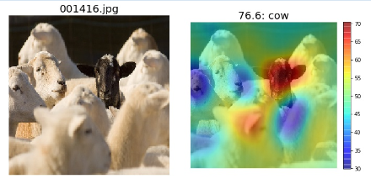
Why Do We Need Explainable AI
○ explain prediction
○ Improve the model
○ Discover bias
Why did the classifier predict “cow” (incorrect)?
Prediction: “cow” 76%
Slide courtesy: Kate Saenko, Boston University

Slide 10
Why Do We Need Explainable AI
○ explain prediction
○ Improve the model
○ Discover bias
Why did the classifier predict “cow” (incorrect)?
Prediction: “cow” 76%
MODEL BIAS:
most sheep are
white, so model
mistakes black
sheep for cows
Slide courtesy: Kate Saenko, Boston University

Slide 11
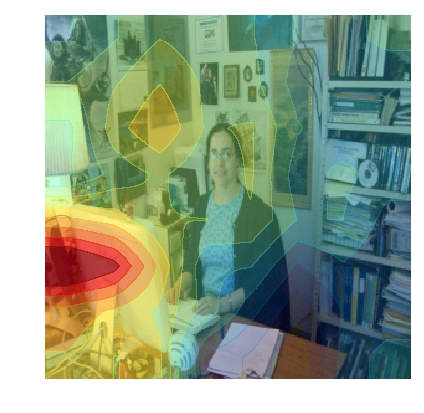
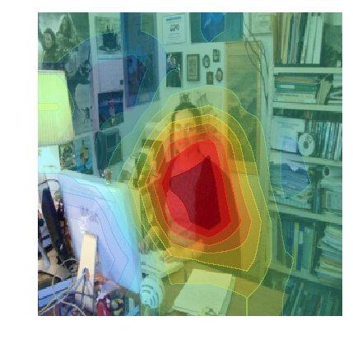
Why Do We Need Explainable AI
○ explain prediction
○ Improve the model
○ Discover bias
Wrong
Right for the Right Reasons
Baseline: A man sitting at a desk with a laptop computer.
Proposed Model: A woman sitting in front of a laptop computer.
Burns, Hendricks, et. al, Women Also Snowboard: Overcoming Bias in Captioning Models

Slide 12
Need for Explainability and Transparency in 3 Stages of AI Evolution
When AI is significantly weaker than humans and not yet readily deployable:
Goal of transparency and explanations is to identify the failure modes.
e.g., open-ended visual question answering (VQA), automated medical diagnosis etc.
When AI is at par with humans and reliably deployable:
Goal of transparency and explanations is to establish trust with users.
e.g., image classification on a set of categories trained on sufficient data
When AI is significantly stronger than humans:
Goal of transparency and explanations is machine teaching – a machine teaching a human how to make accurate predictions
e.g., chess or go playing bots
Slide motivated from - R Selvaraju, A Das, R Vedantam, M Cogswell, D Parikh, D Batra, “Grad-CAM: Why did you say that? Visual Explanations from Deep Networks via Gradient-based Localization”, ICCV 2017
Notes:
THIS IS FROM GRAD-CAM PAPER.

Slide 13
Explainable AI: Different Schools of Thoughts
Occlusion Based Methods:
Activation/Gradient based methods:
Deconvolution based Methods:
Theory of Deep Learning

Slide 14
Activation/Gradient based methods

Slide 15

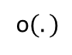
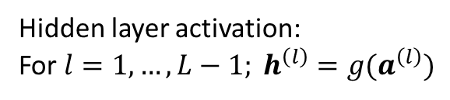
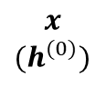
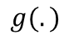
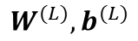
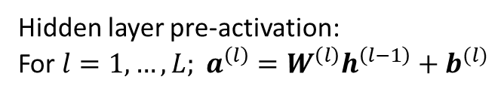
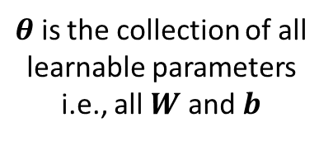
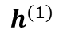
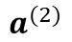
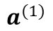
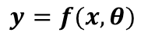
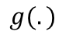
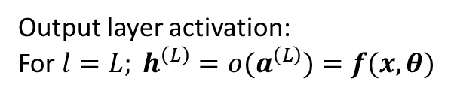
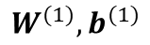
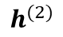
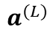
Forward Pass in a Nutshell
$θ$ is the collection of all learnable parameters i.e., all $W$ and $b$
$$x$$
$${(h}^{(0)})$$
$$W^{(1)},b^{(1)}$$
$$g(.)$$
$$W^{(2)},b^{(2)}$$
$$g(.)$$
$$W^{(L)},b^{(L)}$$
o$(.)$
$$y=f(x, θ)$$
$$a^{(1)}$$
$$h^{(1)}$$
$$a^{(2)}$$
$$h^{(2)}$$
$$a^{(L)}$$
Hidden layer pre-activation:
For $l=1,…,L; a^{\left(l\right)}=W^{\left(l\right)}h^{\left(l−1\right)}+b^{(l)}$
Hidden layer activation:
For $l=1,…,L−1; h^{\left(l\right)}={g(a}^{\left(l\right)})$
Output layer activation:
For $l=L; h^{\left(L\right)}={o(a}^{\left(L\right)})=f(x, θ)$

Slide 16
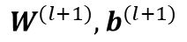
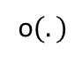
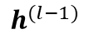
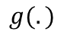
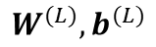
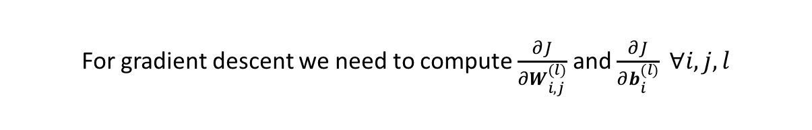
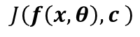
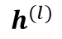
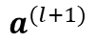
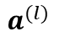
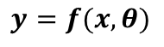
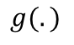
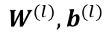
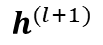
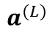
Backpropagation in a Nutshell
$$h^{(l−1)}$$
$$W^{(l)},b^{(l)}$$
$$g(.)$$
$$W^{(l+1)},b^{(l+1)}$$
$$g(.)$$
$$W^{(L)},b^{(L)}$$
o$(.)$
$$y=f(x, θ)$$
$$a^{(l)}$$
$$h^{(l)}$$
$$a^{(l+1)}$$
$$h^{(l+1)}$$
$$a^{(L)}$$
$$J\left(f\left(x, θ\right),c \right)$$
True class of the example
For gradient descent we need to compute $\frac{∂J}{∂W_{i,j}^{(l)}}$ and $\frac{∂J}{∂b_{i}^{(l)}} ∀i,j,l$
Backpropagation consists of intelligent use of the chain rule of differentiation for computation of these gradients

Slide 17
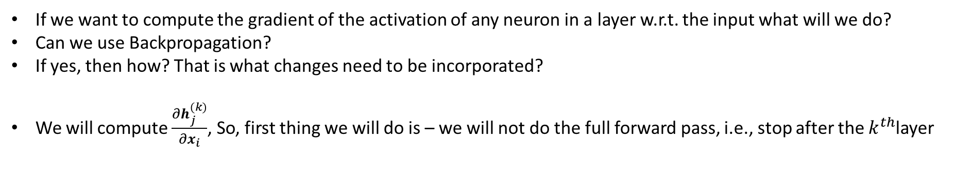
Backpropagation in a Nutshell
$$h^{(l−1)}$$
$$W^{(l)},b^{(l)}$$
$$g(.)$$
$$W^{(l+1)},b^{(l+1)}$$
$$g(.)$$
$$W^{(L)},b^{(L)}$$
o$(.)$
$$y=f(x, θ)$$
$$a^{(l)}$$
$$h^{(l)}$$
$$a^{(l+1)}$$
$$h^{(l+1)}$$
$$a^{(L)}$$
$$J\left(f\left(x, θ\right),c \right)$$
True class of the example
For gradient descent we need to compute $\frac{∂J}{∂W_{i,j}^{(l)}}$ and $\frac{∂J}{∂b_{i}^{(l)}} ∀i,j,l$
Backpropagation consists of intelligent use of the chain rule of differentiation for computation of these gradients
If we want to compute the gradient of the activation of any neuron in a layer w.r.t. the input what will we do?
Can we use Backpropagation?
If yes, then how? That is what changes need to be incorporated?
We will compute $\frac{∂h_{j}^{(k)}}{∂x_{i}}$, So, first thing we will do is – we will not do the full forward pass, i.e., stop after the $k^{th}$layer

Slide 18
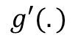
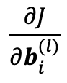

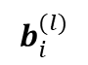
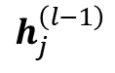
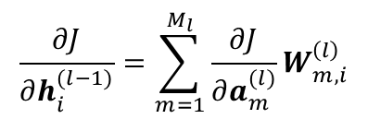

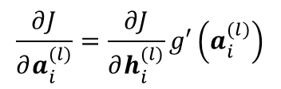
















Backpropagation in a Nutshell
$$\left[W_{m,i}^{(l)} \right]$$
$$\frac{∂J}{∂W_{i,j}^{(l)}}$$
$$\frac{∂J}{∂b_{i}^{(l)}}$$
$$b_{i}^{(l)}$$
$$\left[W_{i,j}^{(l)} \right]$$
$$×$$
$$h_{j}^{\left(l−1\right)}$$
$$×$$
$$+$$
$$a_{i}^{(l)}$$
$$g(.)$$
$$h_{j}^{\left(l\right)}$$
$$\frac{∂J}{∂a_{i}^{(l)}}=\frac{∂J}{∂h_{i}^{(l)}}g′\left(a_{i}^{(l)}\right)$$
… (3)
$$∀i=1:M_{L}$$
$$\frac{∂J}{∂b_{i}^{(l)}}=\frac{∂J}{∂a_{i}^{(l)}}$$
… (2)
$$g′(.)$$
$$\frac{∂J}{∂W_{i,j}^{(l)}}=\frac{∂J}{∂a_{i}^{(l)}}h_{j}^{\left(l−1\right)}$$
… (1)
$$\frac{∂J}{∂h_{i}^{(l−1)}}$$
$$×$$
$$\frac{∂J}{∂a_{i}^{(l)}}$$
$$\frac{∂J}{∂h_{i}^{(l)}}$$
$$\frac{∂J}{∂h_{i}^{(l−1)}}=\sum_{m=1}^{M_{l}}{\frac{∂J}{∂a_{m}^{(l)}}}W_{m,i}^{\left(l\right)}$$
and
$$∀i=1:M_{L}$$
$$×$$
… (4)
$$+$$

Slide 19

Backpropagation in a Nutshell
The very first thing to compute is $\frac{∂h_{j}^{(k)}}{∂h_{j}^{(k)}}$ which is 1 and backpropagate this all the way to the input. (Note, derivatives of $h_{j}^{(k)}$ w.r.t. all other neurons in the $k^{th}$layer are 0)
$$\left[W_{m,i}^{(l)} \right]$$
$$\frac{∂J}{∂W_{i,j}^{(l)}}$$
$$\frac{∂J}{∂b_{i}^{(l)}}$$
$$b_{i}^{(l)}$$
$$\left[W_{i,j}^{(l)} \right]$$
$$×$$
$$h_{j}^{\left(l−1\right)}$$
$$×$$
$$+$$
$$a_{i}^{(l)}$$
$$g(.)$$
$$h_{j}^{\left(l\right)}$$
$$\frac{∂J}{∂a_{i}^{(l)}}=\frac{∂J}{∂h_{i}^{(l)}}g′\left(a_{i}^{(l)}\right)$$
… (3)
$$∀i=1:M_{L}$$
$$\frac{∂J}{∂b_{i}^{(l)}}=\frac{∂J}{∂a_{i}^{(l)}}$$
… (2)
$$g′(.)$$
$$\frac{∂J}{∂W_{i,j}^{(l)}}=\frac{∂J}{∂a_{i}^{(l)}}h_{j}^{\left(l−1\right)}$$
… (1)
$$\frac{∂J}{∂h_{i}^{(l−1)}}$$
$$×$$
$$\frac{∂J}{∂a_{i}^{(l)}}$$
$$\frac{∂J}{∂h_{i}^{(l)}}$$
$$\frac{∂J}{∂h_{i}^{(l−1)}}=\sum_{m=1}^{M_{l}}{\frac{∂J}{∂a_{m}^{(l)}}}W_{m,i}^{\left(l\right)}$$
and
$$∀i=1:M_{L}$$
$$×$$
… (4)
$$+$$

Slide 20











Backpropagation in a Nutshell
The very first thing to compute is $\frac{∂h_{j}^{(k)}}{∂h_{j}^{(k)}}$ which is 1 and backpropagate this all the way to the input. (Note, derivatives of $h_{j}^{(k)}$ w.r.t. all other neurons in the $k^{th}$layer are 0)
$$\left[W_{m,i}^{(l)} \right]$$
$$\frac{∂h_{j}^{(k)}}{∂W_{i,j}^{(l)}}$$
$$\frac{∂h_{j}^{(k)}}{∂b_{i}^{(l)}}$$
$$b_{i}^{(l)}$$
$$\left[W_{i,j}^{(l)} \right]$$
$$×$$
Then, for all $0≤l≤k$
$$h_{j}^{\left(l−1\right)}$$
$$×$$
$$+$$
$$a_{i}^{(l)}$$
$$g(.)$$
$$h_{j}^{\left(l\right)}$$
(Notice the change from $J$ to $h_{j}^{(k)}$)
$$\frac{∂h_{j}^{(k)}}{∂a_{i}^{(l)}}=\frac{∂h_{j}^{(k)}}{∂h_{i}^{(l)}}g′\left(a_{i}^{(l)}\right)$$
… (3)
$$∀i=1:M_{L}$$
$$\frac{∂h_{j}^{(k)}}{∂b_{i}^{(l)}}=\frac{∂h_{j}^{(k)}}{∂a_{i}^{(l)}}$$
… (2)
$$g′(.)$$
$$\frac{∂h_{j}^{(k)}}{∂W_{i,j}^{(l)}}=\frac{∂h_{j}^{(k)}}{∂a_{i}^{(l)}}h_{j}^{\left(l−1\right)}$$
… (1)
$$\frac{∂h_{j}^{(k)}}{∂h_{i}^{(l−1)}}$$
$$×$$
$$\frac{∂h_{j}^{(k)}}{∂a_{i}^{(l)}}$$
$$\frac{∂h_{j}^{(k)}}{∂h_{i}^{(l)}}$$
$$\frac{∂h_{j}^{(k)}}{∂h_{i}^{(l−1)}}=\sum_{m=1}^{M_{l}}{\frac{∂h_{j}^{(k)}}{∂a_{m}^{(l)}}}W_{m,i}^{\left(l\right)}$$
and
$$∀i=1:M_{L}$$
$$×$$
… (4)
$$+$$

Slide 21



How Does It Help?
Helps to understand what excites a neuron the most. That is the interpretation of the gradient of a neuron activation value with respect to the input
A high gradient of an output neuron activation value (i.e., classification score) w.r.t. a certain input pixel implies a small change (perturbation) of that input pixel has a large effect on the classification score represented by that output neuron
Simonyan, Vedaldi, and Zisserman, "Deep Inside Convolutional Networks: Visualising Image Classification Models and Saliency Maps", ICLR Workshop 2014.

Slide 22


How Does It Help?
Helps to understand what sort of images generate maximum score (probability) for a particular class
Use backpropagation to get such an image (not a network i.e., weights of a network) for a particular class
$\arg{\max_{I}{S_{c}\left(I\right)−λ{\left|\left|I\right|\right|}_{2}^{2}}}$ -- Looking for an image $I$ where $S_{c}$ is the score of class $c$
The regularization term restricts the image to have a small number of pixels having very high intensities (Will see different variations in later slides)
"One goose is good, but 10 goose is much more likely goose" - Andrej Karpathy.
Simonyan, Vedaldi, and Zisserman, "Deep Inside Convolutional Networks: Visualising Image Classification Models and Saliency Maps", ICLR Workshop 2014.

Slide 23

Playing with the Regularizer
L-2 regularization (Same as previous work) [Suppressing high amplitude]
Gaussian blur: Images produced by gradient ascent tend to have lots of high frequency information. A useful regularization is to use blur (regularly after a few steps of optimization) [Suppressing high frequency]
Clipping stray pixels with small gradient or small intensities: This will stop stray pixels (possibly not belonging to an object as a whole), to contribute in whatever small way they can to ultimately raise the score
Yosinski, Clune, Nguyen, Fuchs, and Lipson, “Understanding Neural Networks Through Deep Visualization", ICML DL Workshop 2014

Slide 24








Now AM will stand for Activation Map (not Activation Maximization)
c
$$F_{1}$$
$$F_{2}$$
c
c
$$F_{n}$$
$$F_{k}=\frac{1}{Z}\sum_{x,y}{f_{k}(x,y)}$$
$$S_{c}=\sum_{k}{W_{k}^{c}F_{k}}$$
→ Average Pooling
→ Score of class $c$,
$$S_{c}=\sum_{k}{W_{k}^{c}F_{k}}=\sum_{k}{W_{k}^{c}}\frac{1}{Z}\sum_{x,y}{f_{k}(x,y)}=\frac{1}{Z}\sum_{x,y}{\sum_{k}{W_{k}^{c}f_{k}\left(x,y\right)}=\frac{1}{Z}\sum_{x,y}{M_{c}(x,y)}}$$
Where $M_{c}(x,y)=\sum_{k}{W_{k}^{c}f_{k}\left(x,y\right)}$
(First interpretation) Take simple average of activations in a channel and then take weighted average
(Second interpretation) Take weighted average across channels for activations at fixed (x,y) and then take simple average (equivalent to sum)
B. Zhou, A. Khosla, A Lapedriza, A Oliva, A Torralba, “Learning Deep Features for Discriminative Localization”, CVPR 2016

Slide 25


Now AM will stand for Activation Map (not Activation Maximization)
c
$$F_{1}$$
$$F_{2}$$
c
c
$$F_{n}$$
$$S_{c}=\frac{1}{Z}\sum_{x,y}{M_{c}(x,y)}$$
B. Zhou, A. Khosla, A Lapedriza, A Oliva, A Torralba, “Learning Deep Features for Discriminative Localization”, CVPR 2016

Slide 26


Class Activation Map (CAM)
B. Zhou, A. Khosla, A Lapedriza, A Oliva, A Torralba, “Learning Deep Features for Discriminative Localization”, CVPR 2016

Slide 27

Gradient Weighted Class Activation Map (Grad-CAM)
Uses gradient information too to produce localization map of important regions in the image for each class
Grad-CAM is a generalization of CAM and applicable to any CNN-based architecture
Grad-CAM has two important properties – i) Class Discriminative and ii) High-Resolution
R Selvaraju, A Das, R Vedantam, M Cogswell, D Parikh, D Batra, “Grad-CAM: Why did you say that? Visual Explanations from Deep Networks via Gradient-based Localization”, ICCV 2017
Notes:
Gradients have strong information about class decisions. So the authors, here, conjecture that it will be helpful to take gradient information into account also. Gradcam is a generalization to cam and is applicable to any CNN-based architecture.

Slide 28


Gradient Weighted Class Activation Map (Grad-CAM)
Remember CAM - $M_{c}(x,y)=\sum_{k}{W_{k}^{c}f_{k}\left(x,y\right)}$
Two major changes
Use gradient information to weigh the activation $\sum_{k}{α_{k}^{c}f_{k}\left(x,y\right)}$ where, $α_{k}^{c}=\frac{1}{Z}\sum_{x,y}{\frac{∂S_{c}}{{∂f}_{k}\left(x,y\right)}}$
Only positive influence is considered $M_{c}(x,y)=ReLU(\sum_{k}{α_{k}^{c}f_{k}\left(x,y\right)}$)
They also combined Grad-CAM with guided backpropagation
R Selvaraju, A Das, R Vedantam, M Cogswell, D Parikh, D Batra, “Grad-CAM: Why did you say that? Visual Explanations from Deep Networks via Gradient-based Localization”, ICCV 2017

Slide 29

Grad-CAM as Generalization of CAM
Remember CAM - $M_{c}(x,y)=\sum_{k}{W_{k}^{c}f_{k}\left(x,y\right)}$
Remember Grad-CAM (w/o ReLU) -$L_{c}(x,y)=\sum_{k}{α_{k}^{c}f_{k}\left(x,y\right)}$ , where $α_{k}^{c}=\frac{1}{Z}\sum_{x,y}{\frac{∂S_{c}}{{∂f}_{k}\left(x,y\right)}}$
For CAM like architecture (conv-layers -> GAP -> fc layer with softmax), it can be shown that $α_{k}^{c}∝W_{k}^{c}$
Proof in next slide
R Selvaraju, A Das, R Vedantam, M Cogswell, D Parikh, D Batra, “Grad-CAM: Why did you say that? Visual Explanations from Deep Networks via Gradient-based Localization”, ICCV 2017

Slide 30

Grad-CAM as Generalization of CAM
In CAM, average pooling results $F_{k}=\frac{1}{Z}\sum_{x,y}{f_{k}(x,y)}$ … (A)
In CAM, the final score $S_{c}=\sum_{k}{W_{k}^{c}F_{k}}$ … (B)
Taking the gradient of the score for class $c$, w.r.t. the (average pooled) feature map $F_{k}$, we get $\frac{∂S_{c}}{∂F_{k}}=\frac{{∂S_{c}}/{∂f_{k}(x,y)}}{{∂F_{k}}/{∂f_{k}(x,y)}}$
$W_{k}^{c}=\frac{∂S_{C}}{∂f_{k}(x,y)}Z$ … (C)
Use relation (B)
Use relation (A)
R Selvaraju, A Das, R Vedantam, M Cogswell, D Parikh, D Batra, “Grad-CAM: Why did you say that? Visual Explanations from Deep Networks via Gradient-based Localization”, ICCV 2017

Slide 31




Grad-CAM as Generalization of CAM
$W_{k}^{c}=Z\frac{∂S_{C}}{∂f_{k}(x,y)}$ … (C)
Summing both sides over all pixels $(x,y)$, we get
$\sum_{x,y}{W_{k}^{c}}= \sum_{x,y}{Z\frac{∂S_{C}}{∂f_{k}(x,y)}}$
$$⇒ZW_{k}^{c}=Z\sum_{x,y}{\frac{∂S_{C}}{∂f_{k}(x,y)}}$$
$$⇒W_{k}^{c}=\sum_{x,y}{\frac{∂S_{C}}{∂f_{k}(x,y)}}=Zα_{k}^{c} [As, α_{k}^{c}=\frac{1}{Z}\sum_{x,y}{\frac{∂S_{C}}{∂f_{k}(x,y)}}]$$
$$⇒α_{k}^{c}∝W_{k}^{c}$$
R Selvaraju, A Das, R Vedantam, M Cogswell, D Parikh, D Batra, “Grad-CAM: Why did you say that? Visual Explanations from Deep Networks via Gradient-based Localization”, ICCV 2017

Slide 32

Seemingly Unreasonable Predictions have Reasonable Explanations
R Selvaraju, A Das, R Vedantam, M Cogswell, D Parikh, D Batra, “Grad-CAM: Why did you say that? Visual Explanations from Deep Networks via Gradient-based Localization”, ICCV 2017

Slide 33



Occlusion Based Methods
car
Independent search
car
Joint Search
M Zeiler, R Fergus, “Visualizing and Understanding Convolutional Networks”, ECCV 2014

Slide 34






RISE
P[shark]
shark
RISE: Randomized Input Sampling for Explanation of Black-box Models, Petsiuk, Das, Saenko, BMVC 2018
Slide Courtesey: Kate Saenko, Boston University

Slide 35



Explanations for Different Categories
Explanation for Sheep
Explanation for Cow
RISE: Randomized Input Sampling for Explanation of Black-box Models, Petsiuk, Das, Saenko, BMVC 2018
Slide Courtesey: Kate Saenko, Boston University

Slide 36


Localization-based metrics
wind farm
Good explanations don’t have to align well with human-labeled ground truth.
recreational facility
CS60010 / Deep Learning | Explainibility (c) Abir Das
Slide Courtesey: Kate Saenko, Boston University

Slide 37


Causal metrics
Deletion
Insertion
Slide Courtesey: Kate Saenko, Boston University

Slide 38


Evaluation
Causal metrics on ImageNet dataset
Localization metric (pointing game) on MSCOCO and Pascal VOC

Slide 39
Thank You

